Slide 1

Alcoholics Anonymous
Presented by the Public Information Committee
of San Mateo County

Slide 2
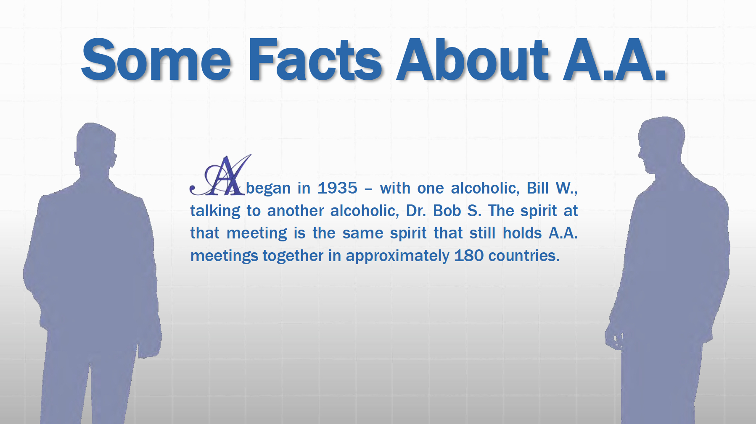

Slide 3


Slide 4
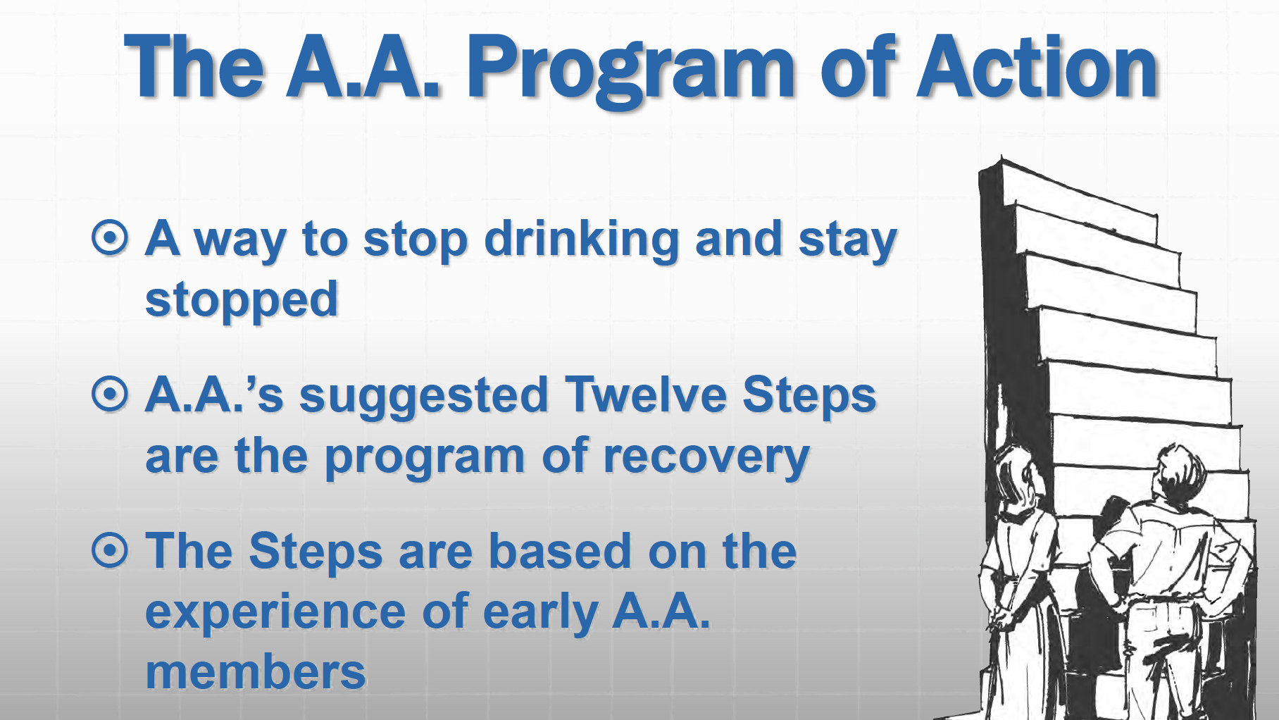

Slide 5


Slide 6
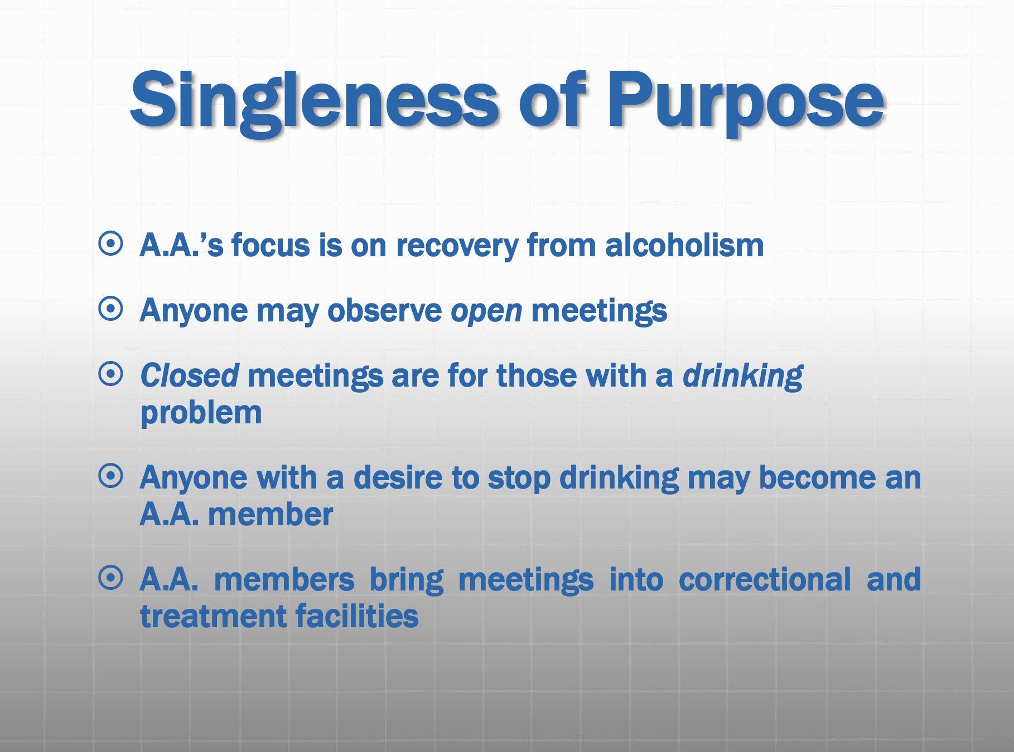

Slide 7

What AA Does:
Accepts ANYONE with a desire to stop drinking
Educates about the “ism” in Alcoholism
  It is not just about drinking, it’s about thinking
Provides a means to clean up the wreckage of our past
  WE are NOT bad people trying to get better WE are sick people trying to get well
Live Happy, Joyous and FREE
What AA Does Not Do:
Recruit members or keep attendance
Make medical or mental diagnoses or run medical facilities
Provide housing, money, jobs, or professional counseling
Endorse outside entities or accept contributions from outside sources

Slide 8

“AA is not a religious organization. Alcoholics Anonymous has only one requirement for membership and that is the desire to stop drinking. There is room in AA for all shades of belief and non-belief.
Many members believe in some sort of god and we have members that come from and practice all sorts of religions; but also many are atheist and agnostic. It’s important to remember that AA is not a religious organization, we have a simple idea that there is a power greater than us as individuals”
From the pamphlet, The “God” Word: Agnostic and Atheist Members in AA

Slide 9


Looking for a meeting?
Meeting schedules for both in-person and online meetings can be found at: https://aa-san-mateo.org or call 650-577-1310 (24/7)
Or use the Meeting Guide app that can be found at: https://www.aa.org/pages/en_US/meeting-guide

Slide 10

Bridging the Gap
Bridging The Gap is a group whose goal is to assist those transitioning from any facility get to an AA meeting. If you need assistance getting to a meeting WE are there. Contact the Bridging The Gap Committee at dist5btg@gmail.com

Slide 11

Public Information and Cooperating with the Professional Community (PI-CPC) Committee provides informational tables, presentations and AA literature to schools, local businesses, parole/probation offices, Health Fairs, religious organizations, civic groups and anywhere the AA message can be useful.
Contact us at dist05.picpc@gmail.com for more information
All our services are at no cost to the public

Slide 12
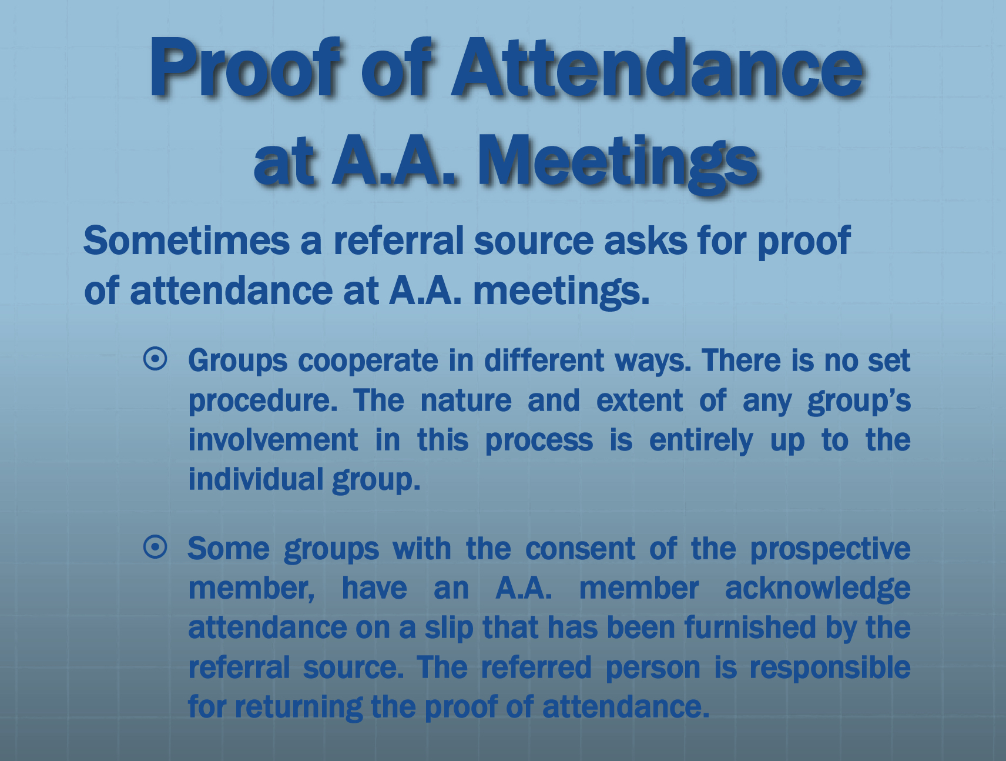

Slide 13

For more information about the recovery program of Alcoholics Anonymous please visit us at https://www.aa.org or contact our local office, info on next slide.

Slide 14


